Slide 1
Review
SET08103 / Software Engineering Methods

Slide 2
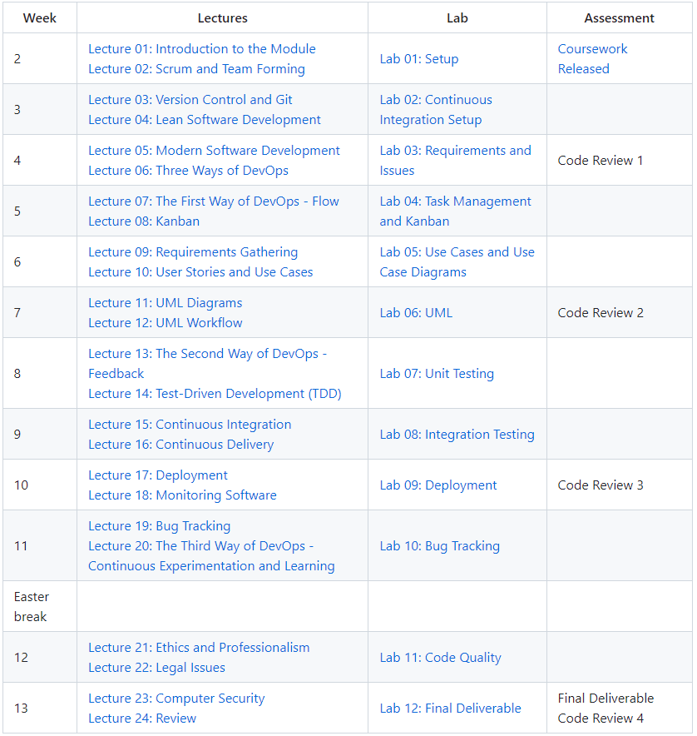
Topics Covered

Slide 3
Module Learning Outcomes
Bold learning outcomes are the focus of the exam.
LO1: Demonstrate understanding of a modern software development lifecycle.
LO2: Explain the different techniques supporting modern software engineering methods.
LO3: Define and analyse systems requirements and needs and specify a system design to deliver these requirements.
LO4: Apply modern software engineering methods and techniques to a software development project.
LO5: Explain the role of a computing professional in relation to social, ethical and legal issues surrounding projects.
LO6: Consider information security requirements in the development and delivery of software.

Slide 4
Exam
Five Questions.
Answer all 4 questions
20 marks per question.
Tuesday 02-May-22 11:00 – 14:00
(Only expected to take a maximum of 2 hours)
Don’t copy paste from slides / google
Write the answers in your own words.

Slide 5

Exam Technique
Answer all 4 questions
Read all of them first before you choose
Start with your best one
Answer the question !
Don’t waste time writing things you know that are not relevant to the question!
Make sure you answer everything that is asked
Look out for key words:
Compare, contrast
Define (brief, exact): Describe (longer)
Look at the available marks
Although the exam is open book your submission will automatically be checked by Turnitin for originality.
Do not be tempted to simply paste answers from online sources
Submissions suspected of plagiarism will be forwarded to the academic conduct officer

Slide 6
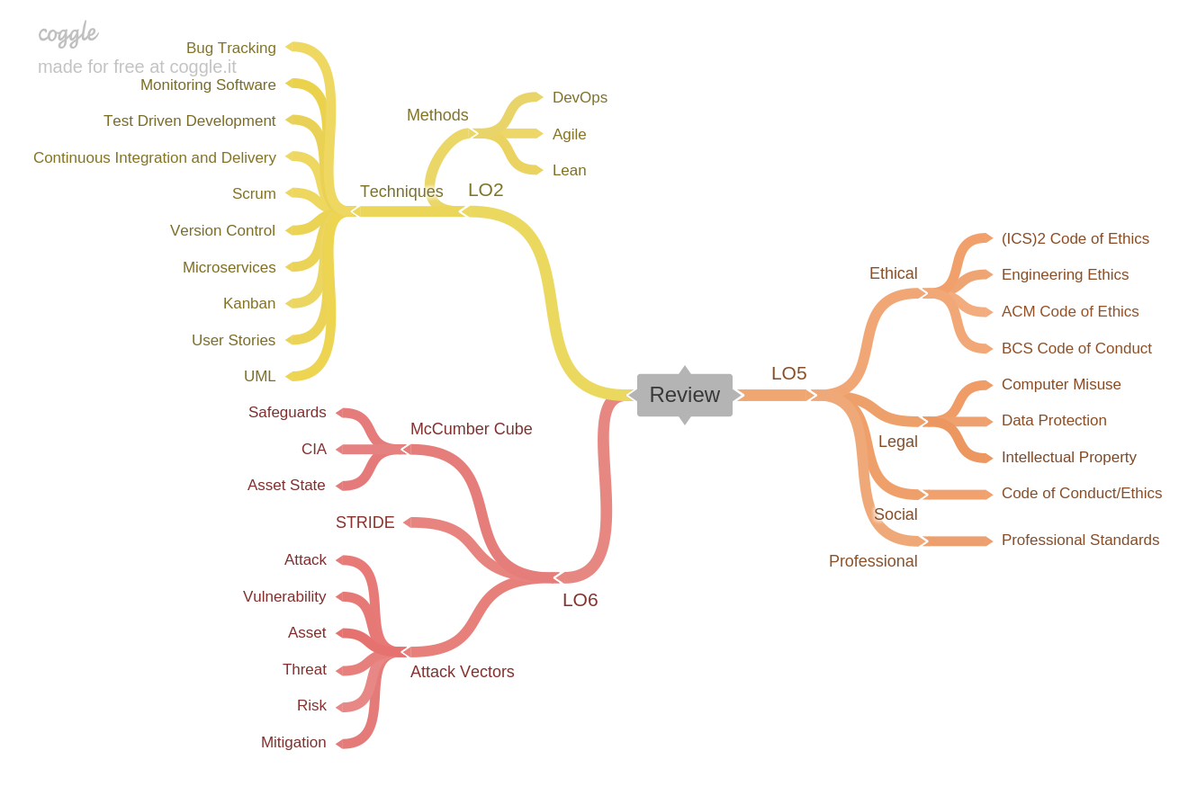
Module Map
Example questions are available on Moodle covering topics from the three learning outcomes.
This talk covers some of the topics from LO2 that were delivered earlier in the Module
Note that the exam could contain questions on anything covered in the module but the emphasis is on Learning Outcomes 2, 5 & 6

Slide 7
Lectures
Lecture 01: Introduction to the Module Lecture 02: Scrum and Team Forming
Lecture 03: Version Control and Git Lecture 04: Lean Software Development
Lecture 05: Modern Software Development Lecture 06: Three Ways of DevOps
Lecture 07: The First Way of DevOps – Flow Lecture 08: Kanban
Lecture 09: Requirements Gathering Lecture 10: User Stories and Use Cases
Lecture 11: UML Diagrams Lecture 12: UML Workflow
Lecture 13: The Second Way of DevOps - Feedback Lecture 14: Test-Driven Development (TDD)
Lecture 15: Continuous Integration Lecture 16: Continuous Delivery
Lecture 17: Deployment Lecture 18: Monitoring Software
Lecture 19: Bug Tracking Lecture 20: The Third Way of DevOps - Continuous Experimentation and Learning
Lecture 21: Ethics and Professionalism Lecture 22: Legal Issues
Lecture 23: Computer Security

Slide 8
LO2 Explain the different techniques supporting modern software engineering methods.
Techniques Covered:
Scrum.
Version Control.
Kanban.
User Stories.
UML.
Microservices.
Test Driven Development.
Continuous Integration and Delivery.
Monitoring Software.
Bug Tracking.
Methods:
Agile.
Lean.
DevOps.

Slide 9
LO2 – Questions to Ask Yourself
Can I explain the different techniques?
Can I explain the different methods?
Can I explain how the techniques support the principles of the methods?

Slide 10
LO2 – Questions to Ask Yourself
Can I explain the different techniques?
Techniques Covered:
Scrum.
Version Control.
Kanban.
User Stories.
UML.
Microservices.
Test Driven Development.
Continuous Integration and Delivery.
Monitoring Software.
Bug Tracking.

Slide 11
LO2 – Questions to Ask Yourself
Can I explain the different techniques?
Techniques Covered:
Scrum. Lecture 2
Version Control.
Kanban.
User Stories.
UML.
Microservices.
Test Driven Development.
Continuous Integration and Delivery.
Monitoring Software.
Bug Tracking.

Slide 12
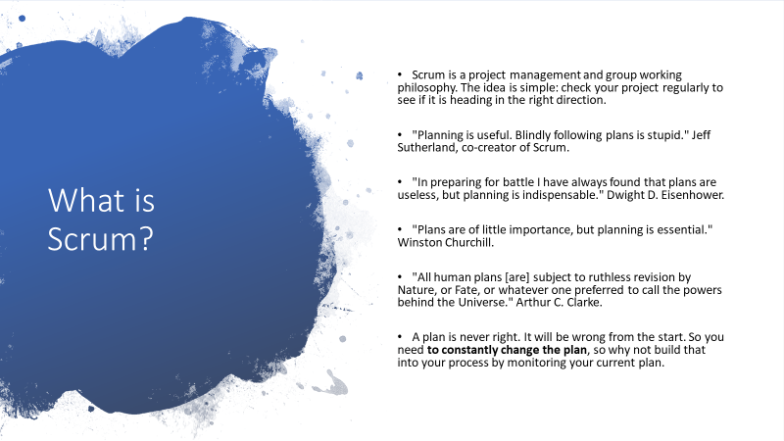
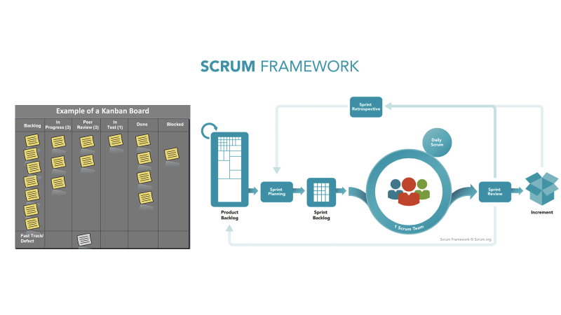
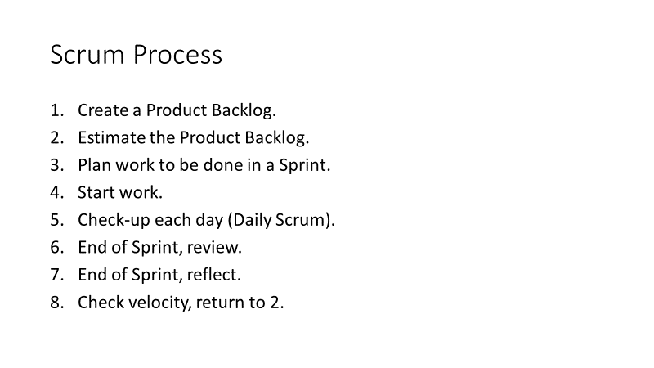
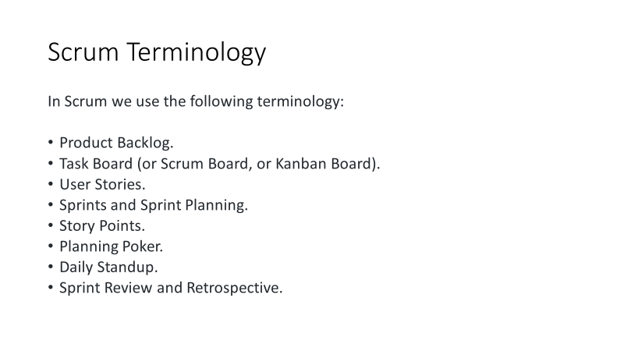

Slide 13
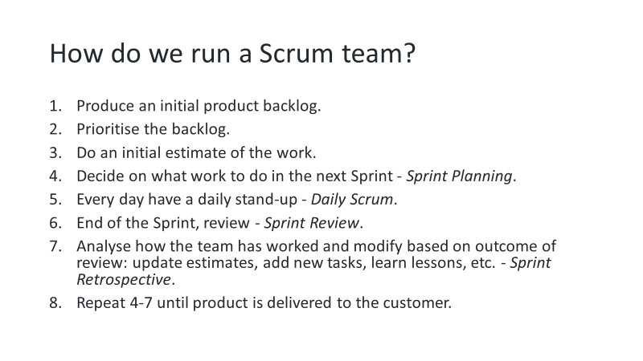
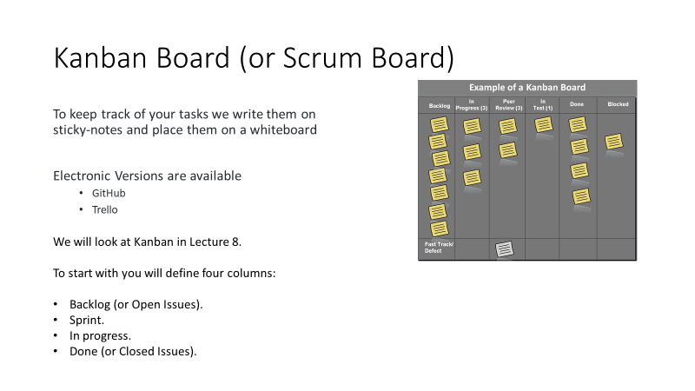
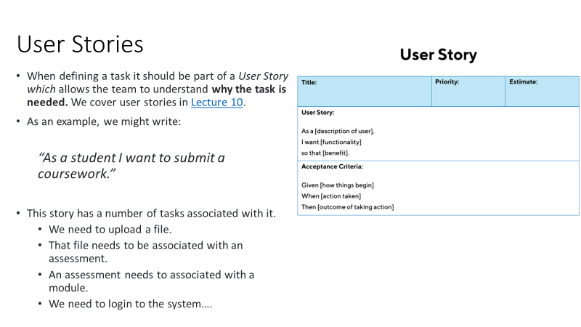
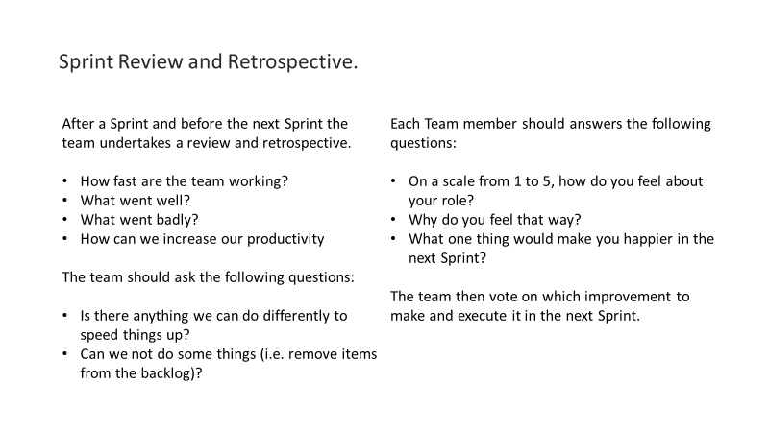

Slide 14
LO2 – Questions to Ask Yourself
Can I explain the different techniques?
Techniques Covered:
Scrum.
Version Control.
Kanban.
User Stories.
UML.
Microservices.
Test Driven Development.
Continuous Integration and Delivery.
Monitoring Software.
Bug Tracking.

Slide 15

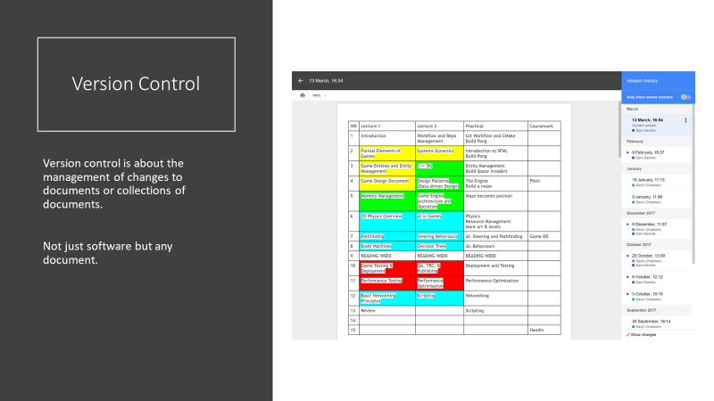
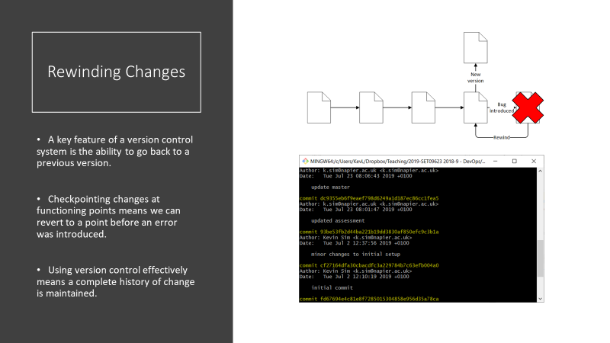
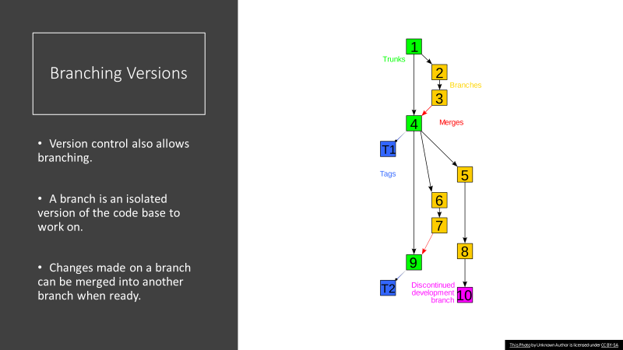

Slide 16
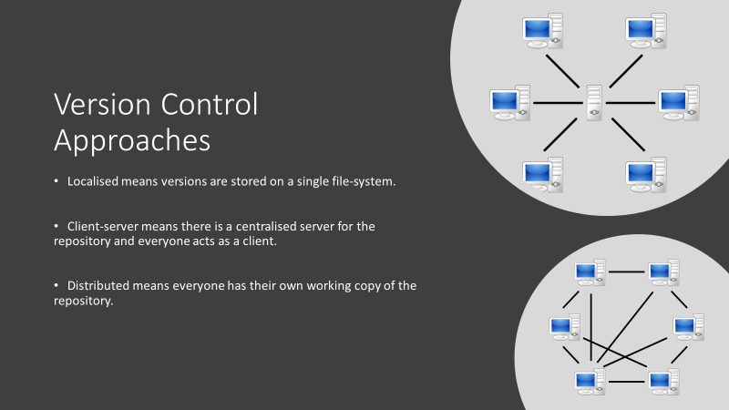
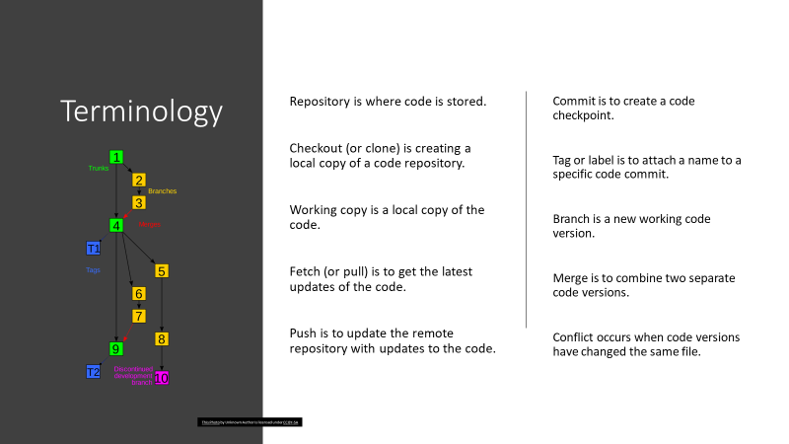
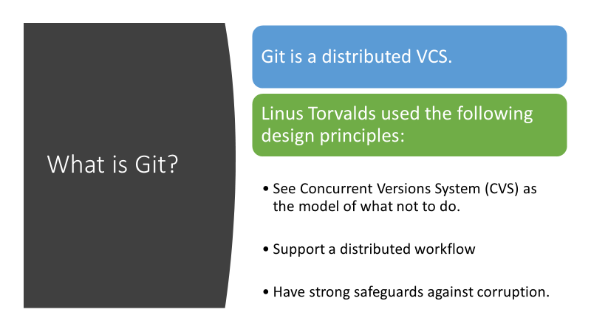
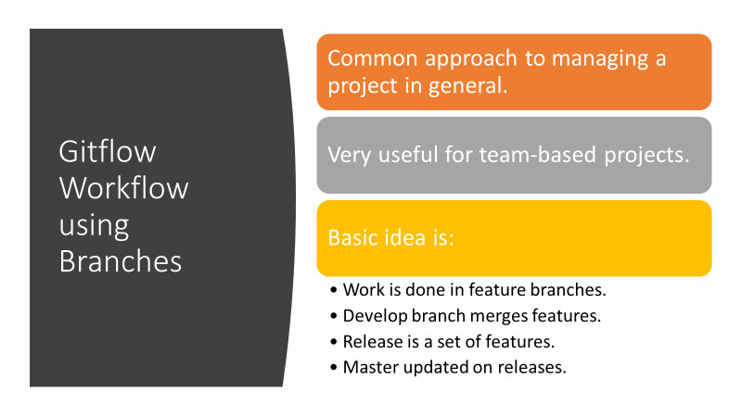

Slide 17
LO2 – Questions to Ask Yourself
Can I explain the different techniques?
Techniques Covered:
Scrum.
Version Control.
Kanban. Etc….
User Stories.
UML.
Microservices.
Test Driven Development.
Continuous Integration and Delivery.
Monitoring Software.
Bug Tracking.

Slide 18
LO2 – Questions to Ask Yourself
Can I explain the different methods?
Methods covered:
Agile.
Lean.
DevOps.
Can I explain the four values of the Agile Manifesto?
Can I explain the seven key principles of Lean Software Development?
Can I explain the three ways of DevOps?

Slide 19
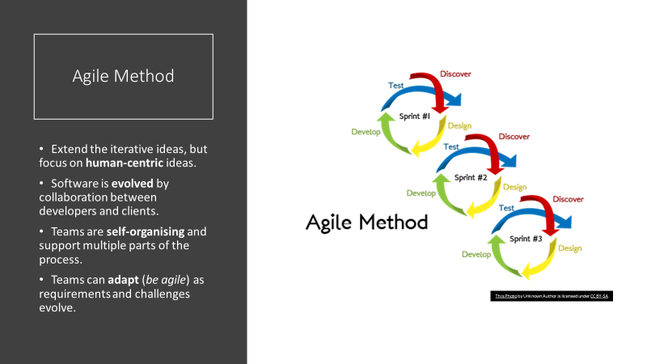
LO2 – Questions to Ask Yourself
Can I explain the four values of the Agile Manifesto?
From Lecture 1
Signatories state that as developers they value:
Individuals and Interactions over processes and tools.
Working Software over comprehensive documentation.
Customer Collaboration over contract negotiation.
Responding to Change over following a plan.

Slide 20
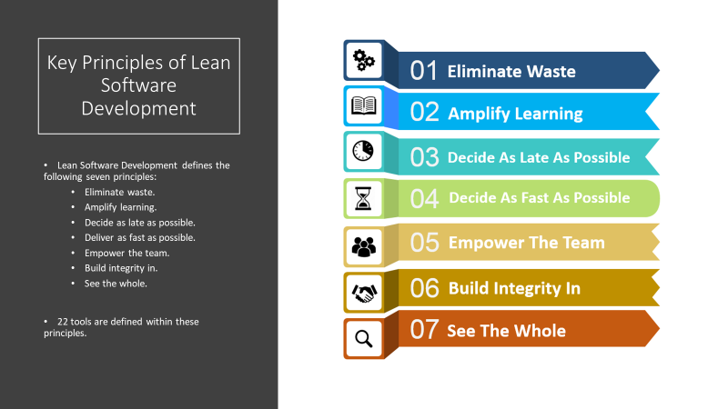
LO2 – Questions to Ask Yourself
Can I explain the seven key principles of Lean Software Development?
From Lecture 4

Slide 21
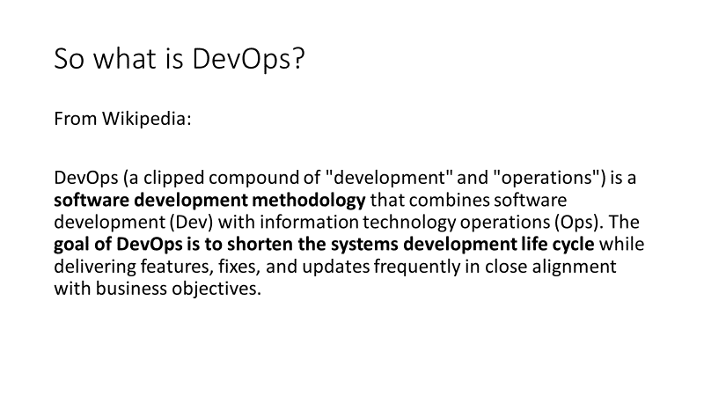
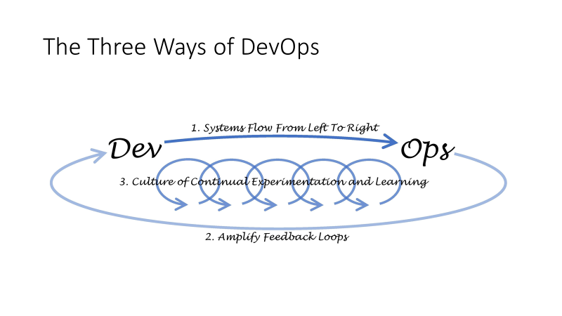
LO2 – Questions to Ask Yourself
Can I explain the three ways of DevOps?
Covered in Lecture 6, 7, 13, 20

Slide 22
LO2 – Questions to Ask Yourself
Can I explain the different techniques?
Can I explain the different methods?
Can I explain the four values of the Agile Manifesto?
Can I explain the seven key principles of Lean Software Development?
Can I explain the three ways of DevOps?
How do the different techniques support Agile?
How do the different techniques support Lean Software Development?
How do the different techniques support DevOps?

Slide 23
LO2 Explain the different techniques supporting modern software engineering methods.
Example Exam Question
The seven principles of Lean Software Development are:
Eliminate waste
Amplify learning
Decide as late as possible
Deliver as fast as possible
Empower the team
Build integrity in
Optimize the whole
In the module we have examined the following techniques:
Scrum.
Version Control.
Kanban.
User stories.
Unit Testing
Continuous Integration and Delivery.
Describe four of the techniques. Specify what principle(s) it can support in Lean and how it does so. (Five marks per technique).
[20 Marks Total]

Slide 24

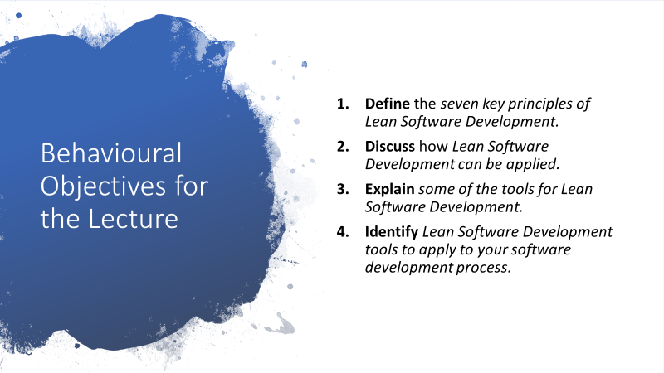
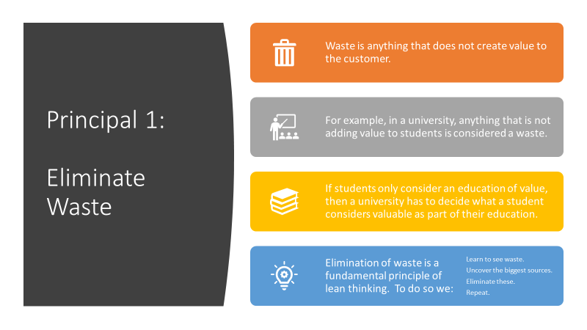
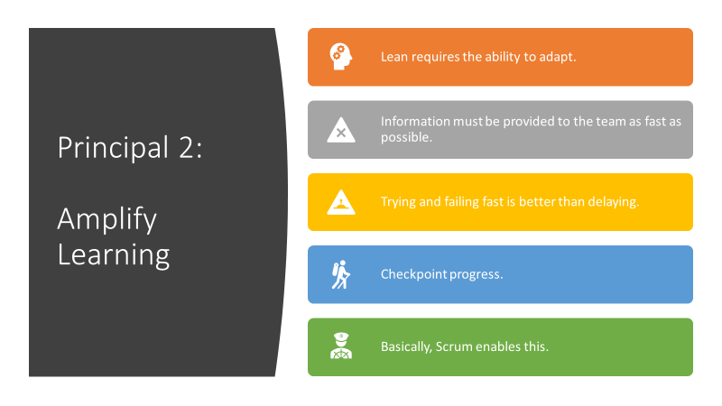

Slide 25
Describe four of the techniques. Specify what principle(s) it can support in Lean and How it does so. (Five marks per technique).
Scrum
Scrum is a project management and group working philosophy. For project management, the idea is simple: check your project regularly to see if it is heading in the right direction.
Scrum helps to eliminate waste by making work visible so that waste can be identified and working practices modified.
Scrum supports the Lean principle of amplifying learning by encouraging ideas and experimentation. Regular meetings allow team members to be allocated to problematic tasks to support other team members where required. Short iterations allow regular feedback to developers to allow quick resolution of issues.
Scrum supports all the principles to a greater or lesser extent.
Eliminate waste
Amplify learning
Decide as late as possible
Deliver as fast as possible
Empower the team
Build integrity in
Optimize the whole

Slide 26
Describe four of the techniques. Specify what principle(s) it can support in Lean and How it does so. (Five marks per technique).
Version Control
VC is about the management of changes to documents or collections of information. Distributed VC facilitates sharing of a code base amongst teams of developers.
VC helps to eliminate waste by making code updates easily accessible to all developers.
VC helps build integrity in through regular tested updates into the system. VC also facilitates easy roll-back to stable versions if needed.
Branching allows individual team members to experiment with features facilitating learning.
Again could provide an answer for all points with a bit of thought
Eliminate waste
Amplify learning
Decide as late as possible
Deliver as fast as possible
Empower the team
Build integrity in
Optimize the whole

Slide 27
Could do the same for the others
Example Exam Question
The seven principles of Lean Software Development are:
Eliminate waste
Amplify learning
Decide as late as possible
Deliver as fast as possible
Empower the team
Build integrity in
Optimize the whole
In the module we have examined the following techniques:
Scrum.
Version Control.
Kanban.
User stories.
Unit Testing
Continuous Integration and Delivery.
Describe four of the techniques. Specify what principle(s) it can support in Lean and how it does so. (Five marks per technique).
[20 Marks Total]

Slide 28
LO2 Explain the different techniques supporting modern software engineering methods.
Techniques Covered:
Scrum.
Version Control.
Kanban.
User Stories.
UML.
Microservices.
Test Driven Development.
Continuous Integration and Delivery.
Monitoring Software.
Bug Tracking.
Methods:
Agile.
Lean.
DevOps.

Slide 29
LO2 Explain the different techniques supporting modern software engineering methods.
Example Exam Question
UML defines several types of diagram, which are useful at different stages of the software development lifecycle. The diagrams can be split into two main types:
a) Identify the two main types of UML diagrams and describe their purpose.
[4 Marks]
b) Identify four UML diagrams. Give a description of each diagrams main features and its purpose and state the type of diagram from categories given above.
[16 Marks]
[20 Marks Total]

Slide 30
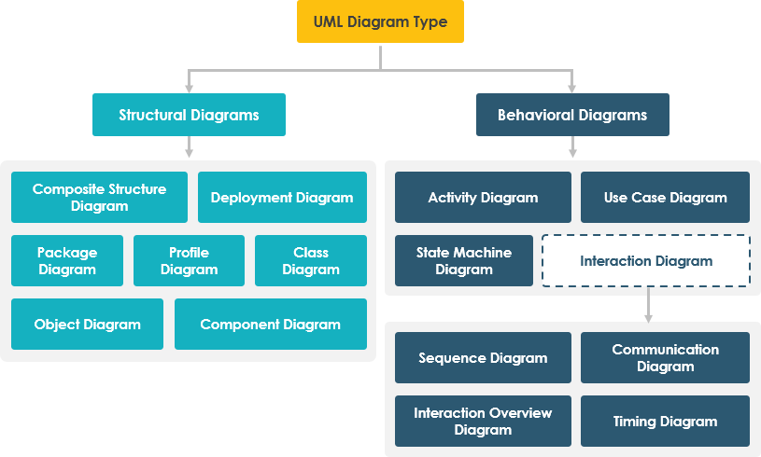
UML Diagram Types
Behavioural diagrams define what happens: the functionality of the system.
Structural diagrams model the architecture and relationship between components of the system.

Slide 31
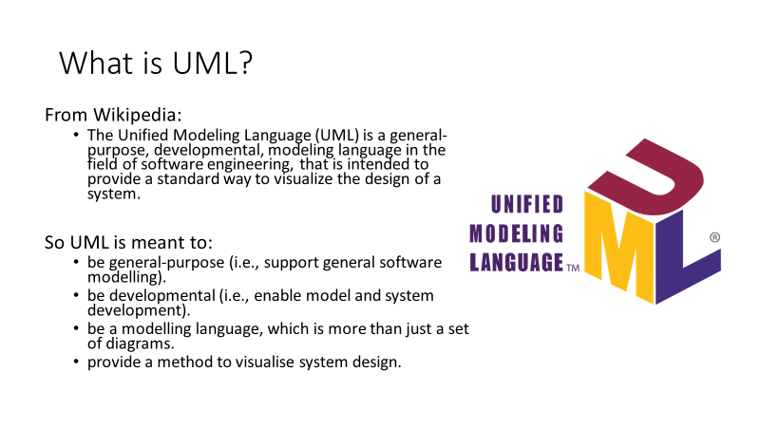
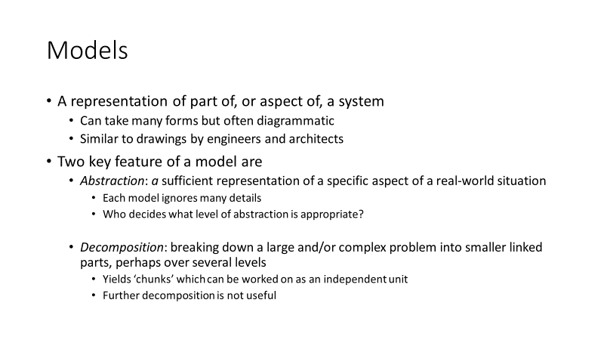
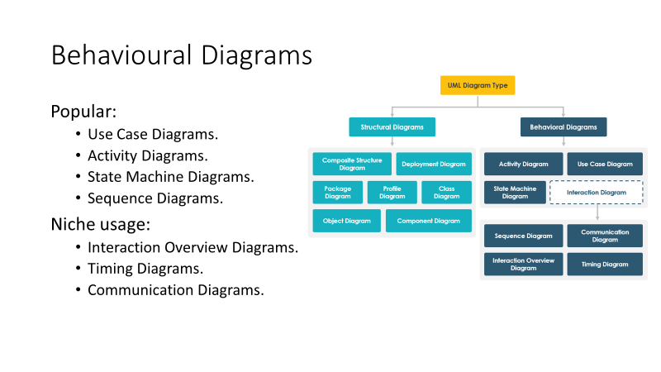
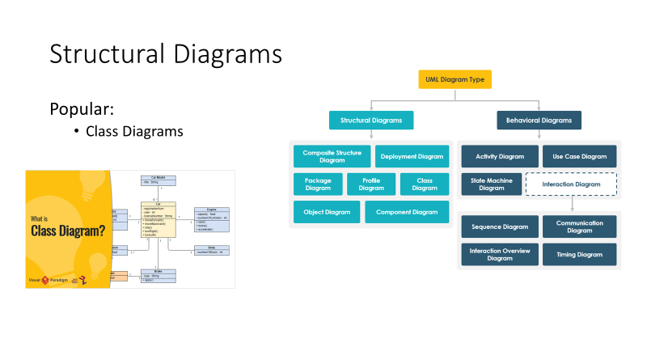

Slide 32
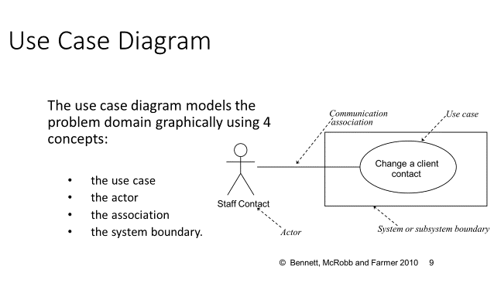
Identify four UML diagrams. Give a description of each diagrams main features and its purpose and state the type of diagram from categories given above. [16 Marks]
The use case diagram is a behavioural diagram that model the functionality of a system from the perspective of its users.
Each use case is an end to end activity that a user or external system may need to complete.
Each use case may be composed of a set of actions, services, and functions that can be described in more detail in a corresponding Use Case Description.
Use Case diagrams are often supplemented with activity diagrams that provide more details of the processes involved in a use case.

Slide 33
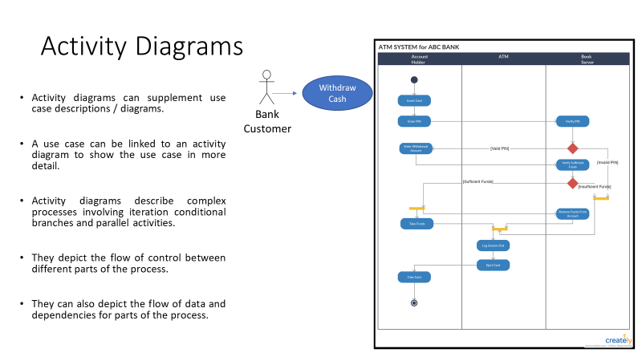
Identify four UML diagrams. Give a description of each diagrams main features and its purpose and state the type of diagram from categories given above. [12 Marks]
The Activity Diagram is a behavioural diagram.
Paraphrase … Don’t copy paste
Activity diagrams break complex activities down into their constituent components. They can accurately depict computational processes involving sequence selection and repetition, the three primary components of any computer program. They can also depict parallel processes.
They can be used to visualise the flow of data between different parts of the process and show the flow of control between actors related to the process.

Slide 34
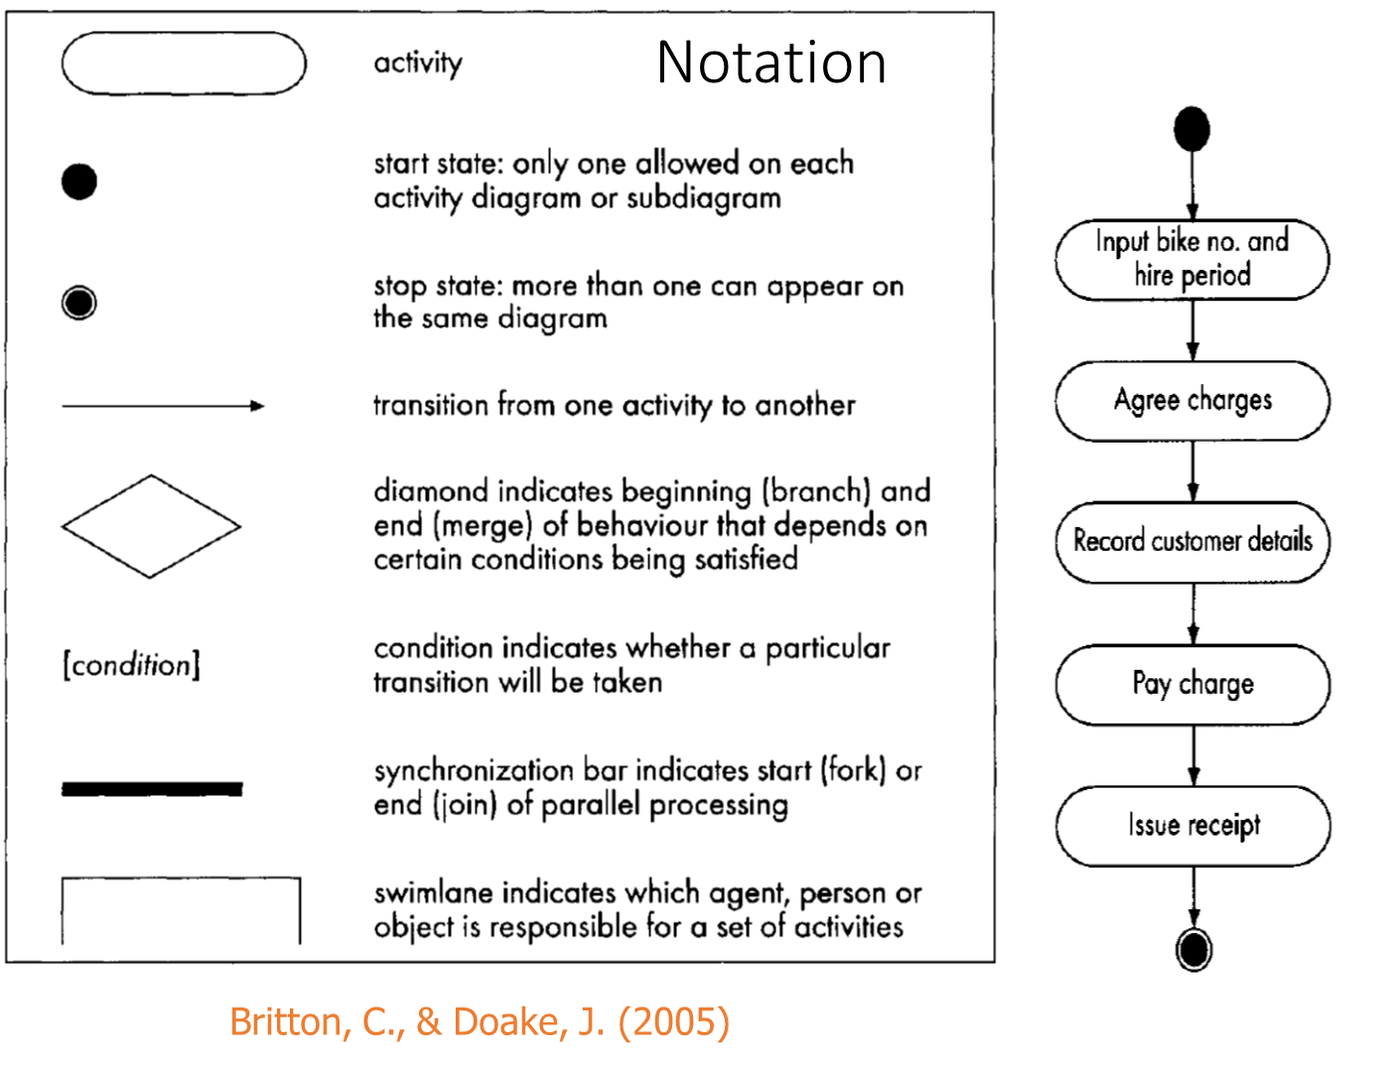
Identify four UML diagrams. Give a description of each diagrams main features and its purpose and state the type of diagram from categories given above. [12 Marks]

Slide 35
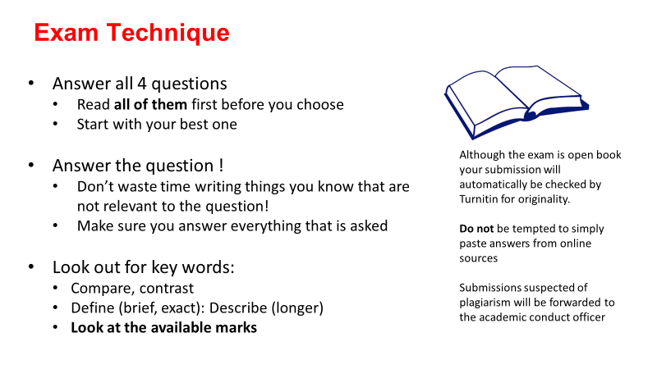
Summary
The lecture material covers everything needed for the exam
The exam focusses on 3 learning outcomes.
LO2: Explain the different techniques supporting modern software engineering methods.
LO5: Explain the role of a computing professional in relation to social, ethical and legal issues surrounding projects.
LO6: Consider information security requirements in the development and delivery of software.

